Slide 1

Automata
languages
lexers, parsers, interpreters

Slide 2
Introduction continued

Slide 3
Basic concepts (more formal)
Language
Alphabet: nonempty set ∑ of symbols
Language: subset of ∑*
Grammar
A means to study language mathematically
Definition of grammar G =(V, T, S, P),
Automata
an abstract model of a digital computer

Slide 4
Grammar
G =(V, T, S, P),
V is a finite set of objects called variables,
T is a finite set of objects called terminal symbols,
S ∈ V is a special symbol called the start variable,
P is a finite set of productions.
The set of all such terminal strings is the language defined or generated by the grammar

Slide 5
Grammar sample
G = ({A, S}, {a, b}, S, P)
With P given by:
S → aAb | λ
A → aAb | λ
Some productions
S => λ
S => aAb => ab
S => aAb => aaAbb => aaaAbbb => aaabbb
L(G) = {a^{n}b^{n :} n ≥ 0}

Slide 6
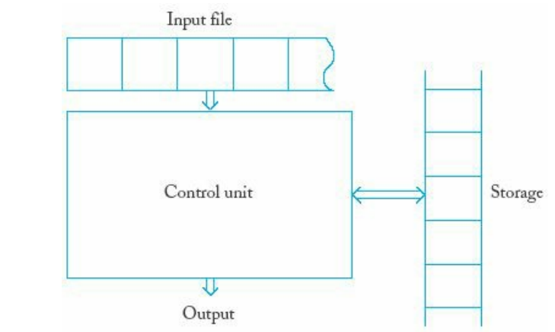
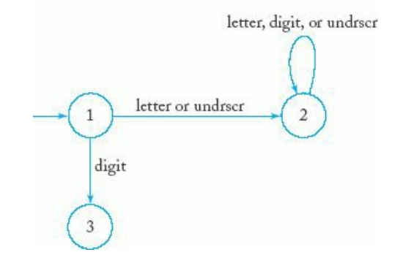
Automata
An automation is an abstract model of a digital computer
Automation can be described by
Grammar
By state transition diagram
Sample accepter accepts all legal C identifiers

